Slide 1
Welcome to Azure Defender + Azure Sentinel Better Together! Day 1

Slide 2
A look into Day 1
Kick-Off | 8:00-8:05 | Welcome | Main Call
 | 8:05-8:30 | Security Center + Azure Defender
 | 8:30-8:45 | Demo Walkthrough
Ingest | 8:45-9:00 | Break
 | 9:00-10:00 | Azure Security Center
 | 10:00-11:00 | Activity: Azure Defender | Table Group Call
 | 11:00-11:15 | Break
 | 11:15-12:00 | Build Hands-on: Azure Defender Part 1 | Table Group Call
Transform | 12:00-1:00 | Break | Main Call
 | 1:00-1:30 | Azure Defender Solutions
 | 1:30-2:00 | Activity: Azure Defender
 | 2:00-3:00 | Build Hands-on: Azure Defender Part 2 | Table Group Call
 | 3:00-:15 | Closing | Main Call
Today we will be learning and collaborating across three spaces:
Main call (this meeting)
Table Group channel within the event Team
CloudLabs Learner Portal & Lab environment
Presentation/
Whole Group
Lab
Activity/ Discussion/ Group Work
Announcements

Slide 3
Security Center + Azure Defender

Slide 4
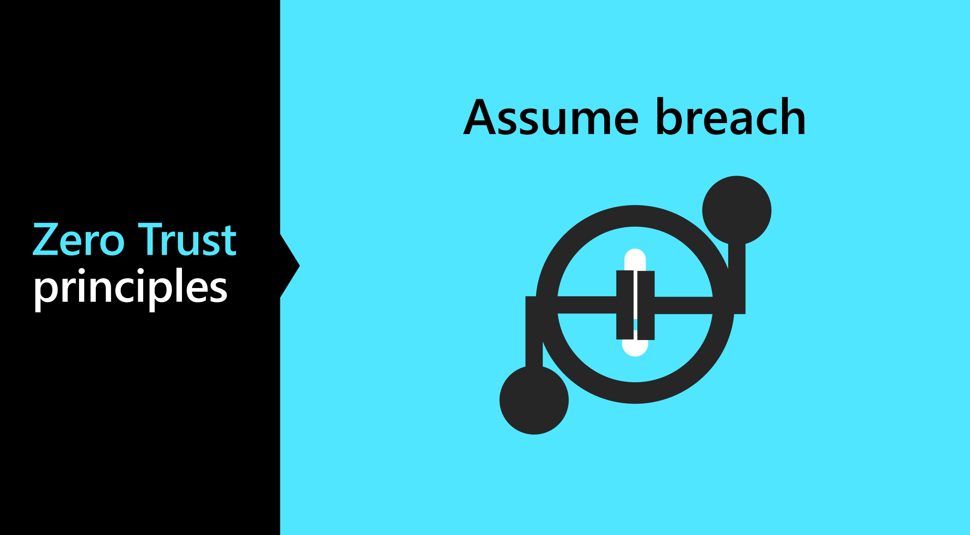

Slide 5

Zero Trust Principles
Verify Explicitly
Use Least Privileged Access
Assume Breach

Slide 6
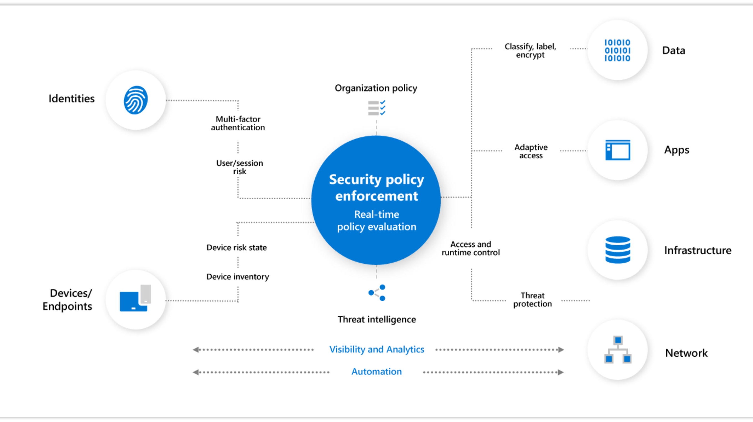

Slide 7

Why Assume Zero Trust?
Mobile Access
Cloud Migration
Risk Mitigation

Slide 8
Common Threats – Data Breaches
Access by an unauthorized 3rd party
Deliberate or accidental action by a controller or processor
Sending personal data to an incorrect recipient
Computing devices containing personal data being lost or stolen
Alteration of personal data without permission
Loss of availability of personal data

Slide 9
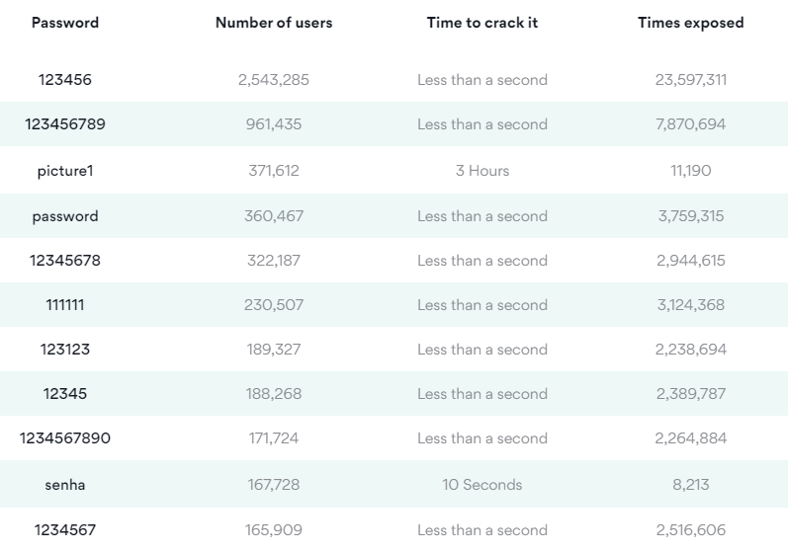
Common Threats – Choice of Passwords

Slide 10
Common Threats - Ransomware
Usually locks screen
Threatens with false accusations in harvesting illegal content
Requires some form of payment to gain access back to your data.

Slide 11
Common Threats - Phishing
Is the fraudulent attempt to obtain sensitive information by impersonating oneself as a trustworthy entity in digital communication.

Slide 12
Common Threats – DDOS (Distributed Denial of Service Attack)
The act of cramming or flooding an incoming traffic from many sources to make impossible to legitimate traffic to pass through .

Slide 13
The cost of not reporting breaches - GDPR
2% of your global turnover or $12,000,000 USD according to article 58

Slide 14
Encryption
Hashing
In Transit
TLS (Transport Layer Security)
Symmetric 1 key
Asymmetric 2 keys (Private and Public Keys)
At Rest
Bitlocker
TDE (Transparent Data Encryption)
Digital Signature Assurance
Can’t convert back

Slide 15
Azure Security Center

Slide 16
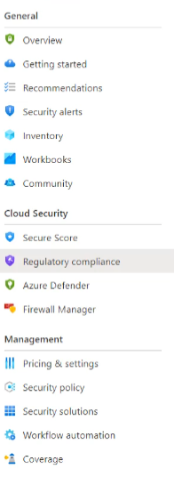
Azure Security Center
Free of Charge
Monitoring service for On Premises and in the Cloud
Log Analytics Agents for Windows and Linux
It is for VMs as well as PAAS systems
Notes:
TODO

Slide 17






Cloud Security
Cloud Security is a top priority at Microsoft
Microsoft invests more than USD 1 billion annually on cybersecurity research and development.
Microsoft employs more than 3,500 security experts who are dedicated to data security and privacy.
Azure has more certifications than any other cloud provider.
Notes:
https://docs.microsoft.com/en-us/compliance/regulatory/offering-home?view=o365-worldwide

Slide 18
Community Repository
Available on GitHub as a valuable resource fore the community
Security recommendations that are in private preview
Programmatic remediation tools for security recommendations
PowerShell scripts for programmatic management
Azure Policy custom definitions for at-scale management of Azure Security Center
Logic App templates that work with Security Center's Logic App connectors (to automate response to Security alerts and recommendations)
Logic App templates that help you run regular tasks or reports within the scope of Azure Security Center
Custom workbooks to visualize Azure Security Center data
Notes:
https://github.com/Azure/Azure-Security-Center

Slide 19
Azure Defender

Slide 20
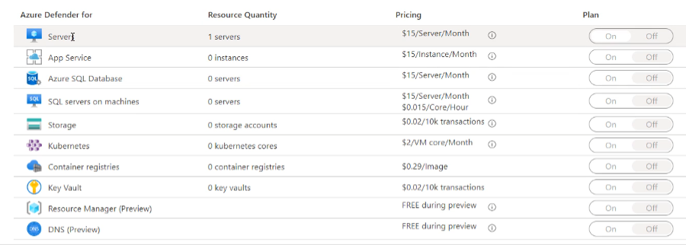
Azure Defender
Paid option
VM Vulnerability Assessment
Just in Time VM Access
Adaptive Application Control
Container Image Scanning
Adaptive Network Hardening
SQL Vulnerability Assessment
File Integrity Monitoring
Network Mapping
IoT Security

Slide 21
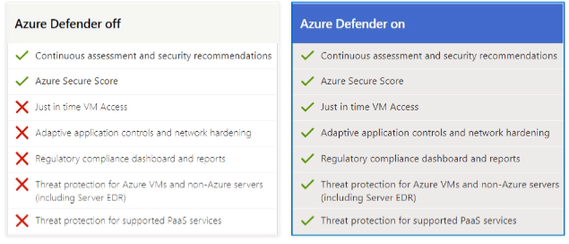
Azure Defender

Slide 22
CSPM Philosophy
Cloud Security Posture Management
Considering Zero Trust Security Model
Considering App Risk Scores
Considering TVM (Threat & Vulnerability Management) for totality of the entire attack Service
Considering the Threat Model Tool

Slide 23
The Concept of SIEM, SOAR and XDR
SIEMs are used for real-time security event analysis to help with investigation, early threat detection and incident response. They also support compliance use cases, as many data regulatory frameworks require organizations to keep audit logs for up to one year.
The key capabilities of SOAR solutions include threat management (help mitigate vulnerabilities), incident response (managing and coordinating response to a security incident) and security operations automation (overall orchestration of workflows, policy execution and reporting).
XDRs centralize normalized data, mostly focusing on products from their own ecosystem. They provide correlated data and alerts into security incidents, and they provide an incident response functionality that can be carried out via security policies.

Slide 24
Log Analytics

Slide 25
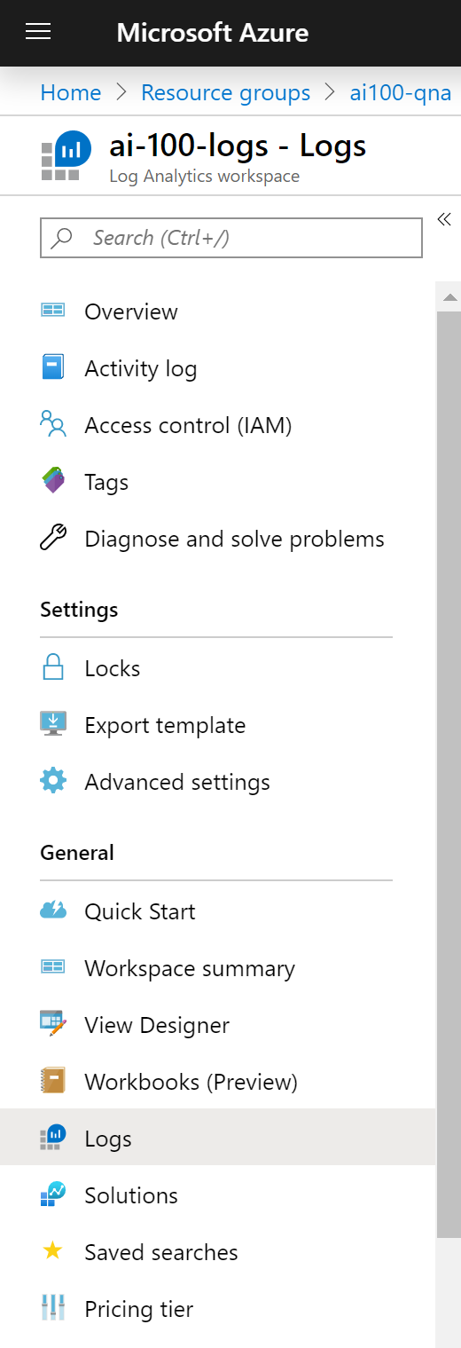
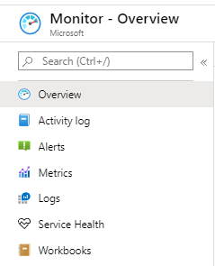
Log Analytics Workspace
The Azure resource used to collect logging data
Linked Azure resources will make corresponding Logs available via blade menu
Logs are queried based on Kusto Query Language (KQL)
Provides limited Visual Designer for building queries
Notes:
Log Analytics is a tool in the Azure portal to edit and run log queries from data collected by Azure Monitor Logs and interactively analyze their results. You can use Log Analytics queries to retrieve records matching particular criteria, identify trends, analyze patterns, and provide a variety of insights into your data.
It can be considered as the basic management unit of Azure Monitor Logs. It is used to collect data from various sources such as Azure Virtual Machines, Windows or Linux Virtual Machines, Azure Resources in a subscription, etc. You may have different resources under different subscriptions and various Azure Monitors to monitor them. An Azure Log Analytics Workspace is a logical storage unit in Azure where all log data generated by Azure Monitors are stored. Azure Log Analytics Workspace makes it easier for us to manage the log data that is collected from various data sources like Azure Virtual Machines.

Slide 26
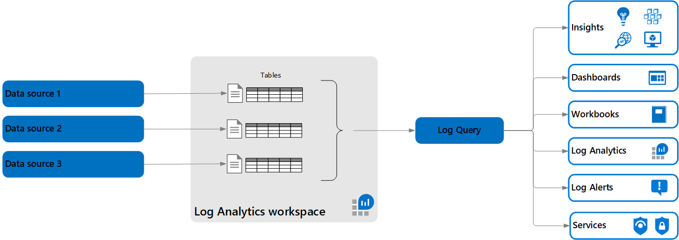
Log Analytics – Architecture
Log queries retrieve their data from a Log Analytics workspace.
Each workspace contains multiple tables are that are organized into separate columns with multiple rows of data. Each table is defined by a unique set of columns that are shared by the rows of data provided by the data source.
Notes:
https://docs.microsoft.com/en-us/azure/azure-monitor/logs/data-platform-logs

Slide 27
Azure Data Explorer
Azure Data Explorer is a fast, fully managed data analytics service for real-time analysis on large volumes of data streaming from applications, websites, IoT devices, and more.
You can use Azure Data Explorer to collect, store, and analyze diverse data to improve products, enhance customer experiences, monitor devices, and boost operations.
A Log Analytics workspace is roughly the equivalent of a database in Azure Data Explorer, tables are structured the same, and both use the same Kusto Query Language (KQL).
The experience of using Log Analytics to work with Azure Monitor queries in the Azure portal is similar to the experience using the Azure Data Explorer Web UI.
Notes:
The ? Mark is the knowledge center

Slide 28
Log Analytics – Dedicated Cluster
Log Analytics dedicated clusters are available for production deployment (registration is required to ensure capacity), supporting high scale and advanced scenarios such as data encryption at rest with Customer-Managed Keys (CMK) and Lockbox.
These dedicated clusters are collections of workspaces rolled into a single managed cluster, which can be used to better handle large scale deployments.
Clusters will only contain workspaces that you select, enabling you to also benefit from cluster-level capacity reservation (starting at 1000GB/day) with discounted pricing.
Notes:
The ? Mark is the knowledge center

Slide 29
Log Analytics – Dedicated Cluster Features
Data Encryption at Rest: Azure Monitor ensures that all data and saved queries are encrypted at rest using Microsoft-managed keys (MMK). Azure Monitor also provides an option for encryption using your own key that is stored in your Azure Key Vault and accessed by storage using system-assigned managed identity authentication. This key (CMK) can be either software or hardware-HSM protected and is available only for dedicated clusters.
LockBox: Lockbox is provided on the Log Analytics dedicated cluster where data is kept in storage accounts under your Lockbox protected subscription. Lockbox gives you control, allowing you to approve or reject Microsoft engineer request to access your data during a support request.
Rate limit: You can have higher ingestion rate limits only on dedicated cluster.
Consistency: You have your own dedicated resources and so there is consistency in terms of performance and latency.
Speed: Cross-workspace queries run faster if all workspaces are on the same cluster.
Notes:
https://docs.microsoft.com/en-us/azure/azure-monitor/logs/logs-dedicated-clusters
https://azure.microsoft.com/en-us/updates/dedicated-clusters-for-azure-monitor-log-analytics-with-cmk-lockbox/

Slide 30
Azure Agents
TODO
Notes:
The ? Mark is the knowledge center

Slide 31
Solutions
TODO
Notes:
The ? Mark is the knowledge center

Slide 32
Kusto Query Language (KQL)
A Kusto query is a read-only request to process data and return results
The request is stated in plain text, using a data-flow model designed to make the syntax easy to read, author, and automate
The query uses schema entities that are organized in a hierarchy similar to SQL's: databases, tables, and columns
https://docs.microsoft.com/en-us/azure/kusto/query/

Slide 33
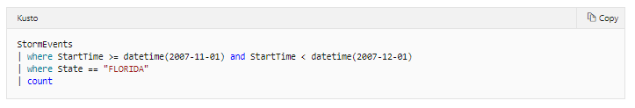
Selecting Data
Start with a reference to a table (StormEvents)
Add a newline starting with a pipe (|) with your where query
Last line will be (|) and the columns you would like returned (count)

Slide 34
KQL – Common Operators
Some useful KQL operators:
where - Filter a table to the subset of rows that satisfy a predicate.
summarize - Produce a table that aggregates the content of the input table.
join - Merge the rows of two tables to form a new table by matching values of the specified column(s) from each table.
count - Return the number of records in the input record set.
top - Return the first N records sorted by the specified columns.
limit - Return up to the specified number of rows.
project - Select the columns to include, rename or drop, and insert new computed columns.
extend - Create calculated columns and append them to the result set.
makeset - Return a dynamic (JSON) array of the set of distinct values that Expr takes in the group
find - Find rows that match a predicate across a set of tables.
Notes:
The ? Mark is the knowledge center

Slide 35
Functions
Functions are reusable queries or query parts
Stored functions, which are user-defined functions that are stored and managed a one kind of a database's schema entities.
Query-defined functions, which are user-defined functions that are defined and used within the scope of a single query. The definition of such functions is done through a let statement.
Built-in functions, which are hard-coded (defined by Kusto and cannot be modified by users).
Notes:
https://docs.microsoft.com/en-us/azure/kusto/query/functions/

Slide 36
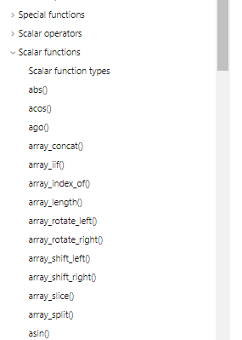
Built-In Functions
Kusto has many pre-defined, built-in functions you can use
Scalar
Aggregation
Window
Time Series Analysis
Machine Learning
Geospatial
Notes:
https://docs.microsoft.com/en-us/azure/azure-monitor/monitor-reference

Slide 37
User-defined Functions
Scalar function
A function with no inputs, or scalar inputs only, and producing a scalar output
Used wherever a scalar expression is allowed.
May only use the row context in which it is defined, and can only refer to tables (and views) that are in the accessible schema.
Tabular function:
A function with no inputs, or at least one tabular input, and producing a tabular output.
Used wherever a tabular expression is allowed.
Notes:
https://docs.microsoft.com/en-us/azure/kusto/query/functions/user-defined-functions

Slide 38
Thank You slide
Break

Slide 39
Welcome Back!
7:00-7:05 | Welcome
7:05-7:15 | Security Center + Azure Defender
7:15-7:45 | Demo Walkthrough
7:45-8:00 | Break
8:00-9:00 | Azure Security Center
9:00-10:00 | Activity: Azure Defender | Table Group Call
10:00-10:15 | Break
10:15-11:00 | Build Hands-on: Azure Defender Part I | Table Group Call
11:00-12:00 | Break | Main Call
12:00-12:30 | Azure Defender Solutions
12:30-13:00 | Activity: Azure Defender | Table Group Call
13:00-14:00 | Build Hands-on: Azure Defender Part 2
14:00-14:15 | Closing | Main Call
Presentation/
Whole Group
Lab
Activity/ Discussion/ Group Work
Announcements

Slide 40
Azure Defender Solutions

Slide 41

Agenda
1 Azure Defender Solutions
TODO
2 Best Practices
TODO

Slide 42
VM + SQL Vulnerability Assessments

Slide 43
Azure Defender – VM Vulnerability Assessment
Azure Defender includes vulnerability scanning for your machines at no extra cost.
Security Center's integrated vulnerability assessment solution works seamlessly with Azure Arc. When you've deployed Azure Arc, your machines will appear in Security Center and no Log Analytics agent is required.

Slide 44
Qualys Scanner
The vulnerability scanner included with Azure Security Center is powered by Qualys. Qualys' scanner is one of the leading tools for real-time identification of vulnerabilities.
You don't need a Qualys license or even a Qualys account - everything's handled seamlessly inside Security Center.
The Azure Security Center vulnerability assessment extension (powered by Qualys), like other extensions, runs on top of the Azure Virtual Machine agent. Runs as Local Host on Windows, and Root on Linux.
During setup, Security Center checks to ensure that the machine can communicate with the following two Qualys data centers (via port 443 - the default for HTTPS):
64.39.104.113 - Qualys' US data center
154.59.121.74 - Qualys' European data center
Notes:
Qualys Terms:
https://ascva.blob.core.windows.net/vadocs/ASC-Qualys-%20EULA.pdf

Slide 45
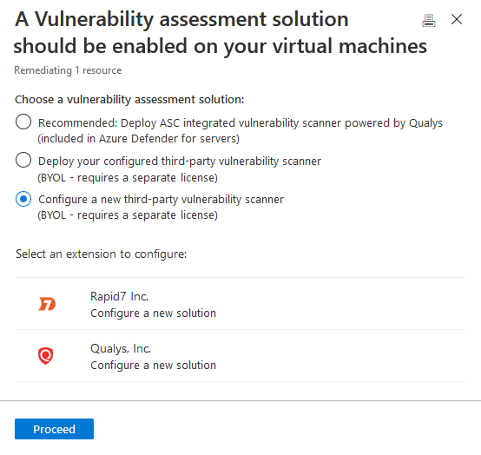
Third-party vulnerability scanners
The BYOL options refer to supported third-party vulnerability assessment solutions. Currently both Qualys and Rapid7 are supported providers.
Supported solutions report vulnerability data to the partner's management platform. In turn, that platform provides vulnerability and health monitoring data back to Security Center.
Notes:
Qualys Terms:
https://ascva.blob.core.windows.net/vadocs/ASC-Qualys-%20EULA.pdf

Slide 46
Azure Defender – SQL Vulnerability
SQL vulnerability assessment is an easy-to-configure service that can discover, track, and help you remediate potential database vulnerabilities.
The service employs a knowledge base of rules that flag security vulnerabilities.
It highlights deviations from best practices, such as misconfigurations, excessive permissions, and unprotected sensitive data.
Assessment Rules cover both database-level issues as well as server-level security issues, like server firewall settings and server-level permissions. These rules also represent many of the requirements from various regulatory bodies to meet their compliance standards.
Notes:
https://docs.microsoft.com/en-us/azure/security-center/deploy-vulnerability-assessment-vm
https://docs.microsoft.com/en-us/azure/azure-sql/database/sql-database-vulnerability-assessment-rules

Slide 47
File Integrity

Slide 48
File Integrity
File integrity monitoring (FIM), also known as change monitoring, examines operating system files, Windows registries, application software, Linux system files, and more, for changes that might indicate an attack.
Security Center recommends entities to monitor with FIM, and you can also define your own FIM policies or entities to monitor.
FIM alerts you for suspicious activity such as:
File and registry key creation or removal
File modifications (changes in file size, access control lists, and hash of the content)
Registry modifications (changes in size, access control lists, type, and the content)

Slide 49
Pop Quiz
Which one of these is NOT a component of a Synapse pipeline?
A) I.R.
B)
Linked Service
C)
Table
D) Activity

Slide 50
Container Image Scanning

Slide 51

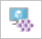
Container Protection
Kubernetes clusters - Continuous assessment of your clusters to provide visibility into misconfigurations and guidelines to help you mitigate identified threats.
Container hosts - Continuous assessment of your Docker environments to provide visibility into misconfigurations and guidelines to help you mitigate threats
Azure Container Registry (ACR) - Vulnerability assessment and management tools for the images in your Azure Resource Manager-based ACR registries

Slide 52
Azure Kubernetes Service
Defends your Kubernetes clusters whether they're hosted in Azure Kubernetes Service (AKS), on-premises, or on other cloud providers. clusters.
Azure Security Center and AKS form a cloud-native Kubernetes security offering with environment hardening, workload protection, and run-time protection
Provides cluster-level threat protection by monitoring your clusters' logs.
Notes:
https://docs.microsoft.com/en-us/azure/security-center/alerts-reference#alerts-k8scluster
https://docs.microsoft.com/en-us/azure/security-center/alerts-reference#alerts-containerhost

Slide 53
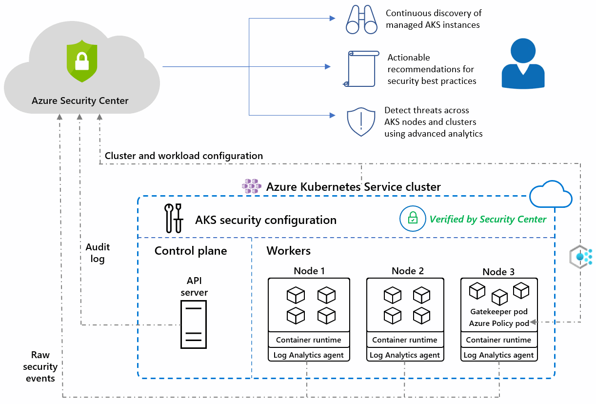
Azure Kubernetes Service
Notes:
https://docs.microsoft.com/en-us/azure/security-center/defender-for-kubernetes-introduction

Slide 54
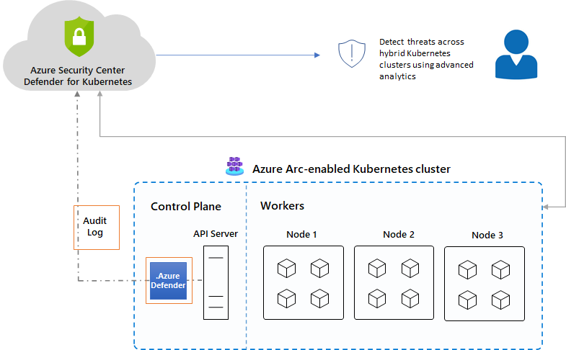
Azure Arc enabled AKS
The Azure Defender for Kubernetes clusters extension can defend your on-premises clusters with the same threat detection capabilities offered for Azure Kubernetes Service clusters.
Notes:
https://docs.microsoft.com/en-us/azure/security-center/defender-for-kubernetes-azure-arc?tabs=k8s-deploy-asc%2Ck8s-verify-asc%2Ck8s-remove-arc

Slide 55
Container Image Scanning
Security Center scans any images pulled within the last 30 days, pushed to your registry, or imported.
The integrated scanner is provided by the industry-leading vulnerability scanning vendor, Qualys.
Findings include related information such as remediation steps, relevant CVEs, CVSS scores, and more.
You can view the identified vulnerabilities for one or more subscriptions, or for a specific registry.
Use the ACR tools to bring images to your registry from Docker Hub or Microsoft Container Registry. When the import completes, the imported images are scanned by Azure Defender.
Notes:
https://docs.microsoft.com/en-us/azure/security-center/defender-for-container-registries-usage

Slide 56
Container Scanning (Docker)
Azure Security Center identifies unmanaged containers hosted on IaaS Linux VMs, or other Linux machines running Docker containers.
When you're exploring the security issues of a VM, Security Center provides additional information about the containers on the machine. Such information includes the Docker version and the number of images running on the host.
Security Center includes the entire ruleset of the CIS Docker Benchmark and alerts you if your containers don't satisfy any of the controls. When it finds misconfigurations, Security Center generates security recommendations.
The CIS benchmark checks don't run on AKS-managed instances or Databricks-managed VMs.

Slide 57
Adaptive Application Control
Notes:
Back to me

Slide 58
Adaptive Application Control
Intelligent and automated solution for defining allow lists of known-safe applications for your machines.
Uses machine learning to analyze the applications running on your machines and create a list of the known-safe software.
By defining lists of known-safe applications, and generating alerts when anything else is executed, you can achieve multiple hardening goals:
Identify potential malware, even any that might be missed by antimalware solutions
Improve compliance with local security policies that dictate the use of only licensed software
Avoid running old or unsupported applications
Prevent specific software that's banned by your organization
Increase oversight of apps that access sensitive data
Notes:
No enforcement options are currently available. Adaptive application controls are intended to provide security alerts if any application runs other than the ones you've defined as safe.

Slide 59
Adaptive Network Hardening
Notes:
Back to me

Slide 60
Adaptive Network Hardening
Adaptive network hardening is an agentless feature of Azure Security Center - nothing needs to be installed on your machines to benefit from this network hardening tool.
Provides recommendations to further harden NSG rules.
It uses a machine learning algorithm that factors in actual traffic, known trusted configuration, threat intelligence, and other indicators of compromise, and then provides recommendations to allow traffic only from specific IP/port tuples.
Adaptive network hardening recommendations are only supported on specific ports.
Notes:
13, 17, 19, 22, 23, 53, 69, 81, 111, 119, 123, 135, 137, 138, 139, 161, 162, 389, 445, 512, 514, 593, 636, 873, 1433, 1434, 1900, 2049, 2301, 2323, 2381, 3268, 3306, 3389, 4333, 5353, 5432, 5555, 5800, 5900, 5900, 5985, 5986, 6379, 6379, 7000, 7001, 7199, 8081, 8089, 8545, 9042, 9160, 9300, 11211, 16379, 26379, 27017, 37215

Slide 61
Just In Time VM Access
Notes:
Back to me

Slide 62
JIT VM Access
Lock down inbound traffic to your Azure Virtual Machines with Azure Security Center's just-in-time (JIT) virtual machine (VM) access feature.
Select the ports on the VM to which inbound traffic will be blocked.
Ensures "deny all inbound traffic" rules exist for your selected ports in the network security group (NSG) and Azure Firewall rules.
When a user requests access to a VM, Security Center checks that the user has Azure role-based access control (Azure RBAC) permissions for that VM.
If the request is approved, Security Center configures the NSGs and Azure Firewall to allow inbound traffic to the selected ports from the relevant IP address (or range), for the amount of time that was specified
After the time has expired, Security Center restores the NSGs to their previous states. Connections that are already established are not interrupted.

Slide 63
Network Map
Notes:
Back to me

Slide 64
Network Map
Provides a graphical view with security overlays giving you recommendations and insights for hardening your network resources.
Using the map you can see the network topology of your Azure workloads, connections between your virtual machines and subnets, and the capability to drill down from the map into specific resources and the recommendations for those resources.
The network map can show you your Azure resources in a Topology view and a Traffic view.
Notes:
The ? Mark is the knowledge center

Slide 65
Topology View
In the inner circle, you can see all the Vnets within your selected subscriptions, the next circle is all the subnets, the outer circle is all the virtual machines.
The lines connecting the resources in the map let you know which resources are associated with each other, and how your Azure network is structured.
If there are too many resources being displayed on the map, Azure Security Center uses its proprietary algorithm to smart cluster your resources, highlighting the resources that are in the most critical state, and have the highest severity recommendations.
Notes:
The ? Mark is the knowledge center

Slide 66
Traffic View
The Traffic view provides you with a map of all the possible traffic between your resources.
This provides you with a visual map of all the rules you configured that define which resources can communicate with whom.
View existing configuration of the network security groups as well as quickly identify possible risky configurations within your workloads.
The strength of this view is in its ability to show you these allowed connections together with the vulnerabilities that exist, so you can use this cross-section of data to perform the necessary hardening on your resources.
For example, you might detect two machines that you weren’t aware could communicate, enabling you to better isolate the workloads and subnets.
Notes:
The ? Mark is the knowledge center

Slide 67
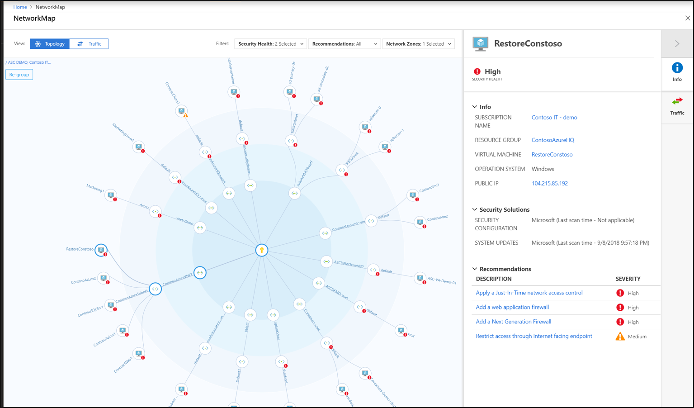
Network Map
Notes:
The ? Mark is the knowledge center

Slide 68
IoT Security
Notes:
Back to me

Slide 69

IoT Security
Defender for IoT connects both to the Azure cloud and to on-premises components.
The solution is designed for scalability in large and geographically distributed environments with multiple remote locations.
This solution enables a multi-layered distributed architecture by country, region, business unit, or zone.
Provides both agent and agentless solutions with cloud and offline deployments
Notes:
https://docs.microsoft.com/en-us/azure/defender-for-iot/architecture

Slide 70
Agent-based
TODO
Notes:
The ? Mark is the knowledge center

Slide 71
Agentless-based (IoT Sensors)
The Defender for IoT sensors discover, and continuously monitor network devices.
Sensors collect ICS network traffic using passive (agentless) monitoring on IoT and OT devices.
Purpose-built for IoT and OT networks, the agentless technology delivers deep visibility into IoT and OT risk within minutes of being connected to the network.
It has zero performance impact on the network and network devices due to its non-invasive, Network Traffic Analysis (NTA) approach.
Notes:
The ? Mark is the knowledge center

Slide 72
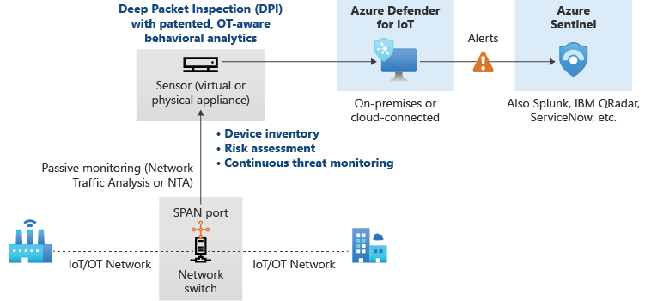
Offline
Notes:
The ? Mark is the knowledge center

Slide 73
Best Practices

Slide 74


Question…
How many different methods of loading ADLS can you think of?
What about a Synapse SQL Pool?

Slide 75
Best Practices
TODO
Notes:
The ? Mark is the knowledge center

Slide 76
Session and Lab Environment

Slide 77
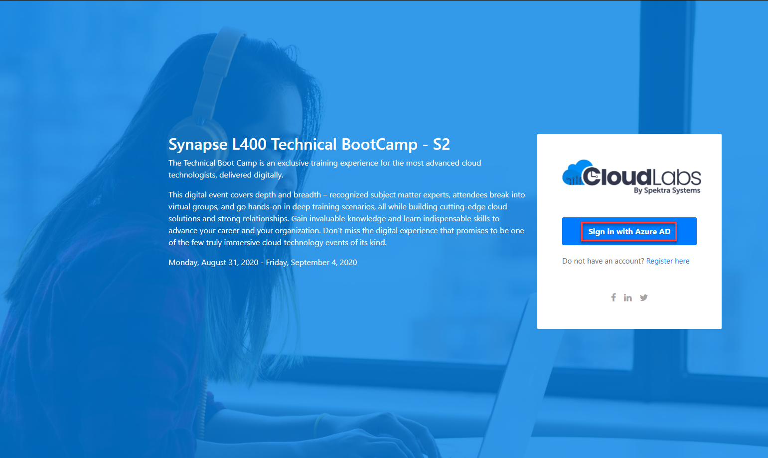
Login to the portal
Notes:
If they don’t have the emails.
Register link: https://bit.ly/32qwla3
Activation Code: ACTIVATE13799

Slide 78
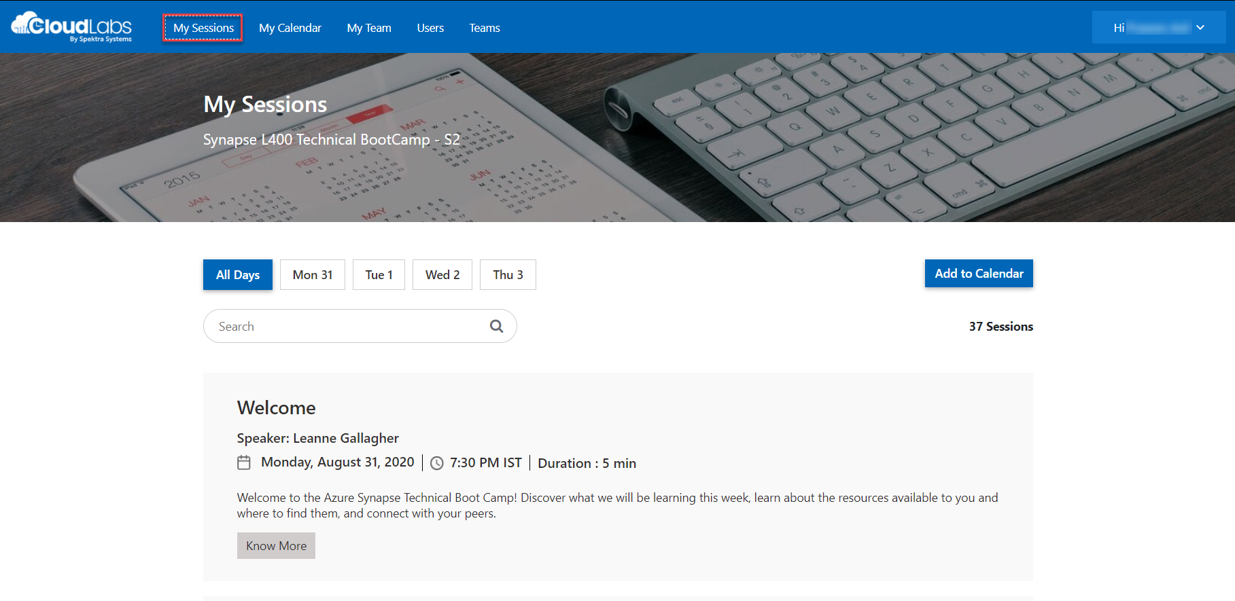
Sessions for Bootcamp

Slide 79
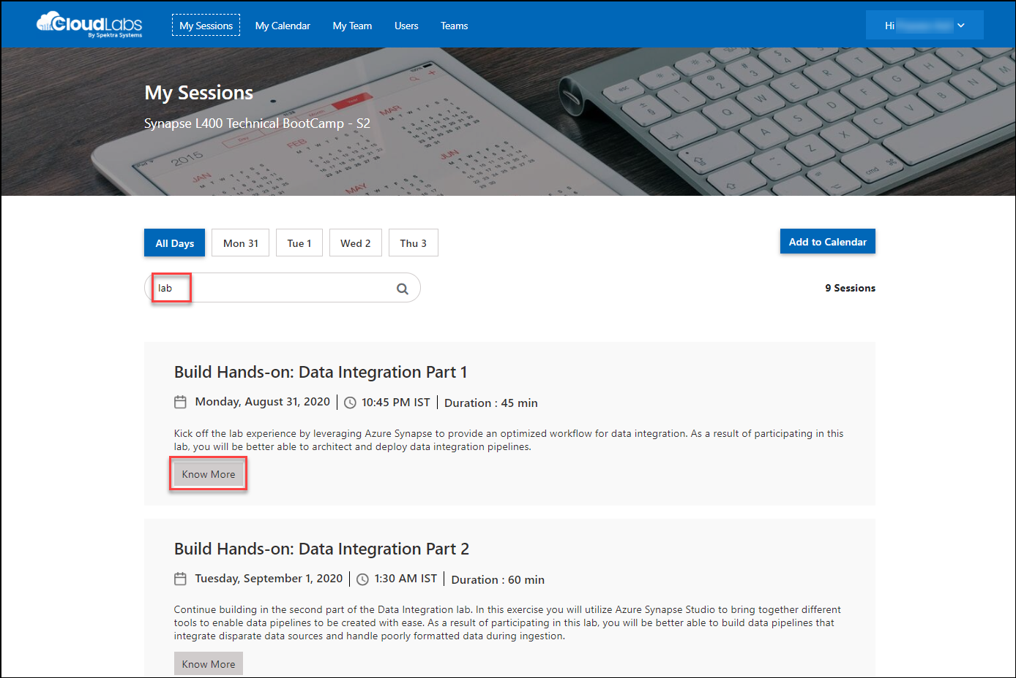
Search for lab
Search for lab
Click on Know More

Slide 80
Thank You slide
Break

Slide 81
DEMO: How to whiteboard designs

Slide 82
Breakout Activity: Azure Defender
As a result of participating in this activity, you will better be able to configure Azure Defender solutions
OUTCOMES
ACTIVITY
60 minutes
Learning Adviser
Table Group Channel
As a team review WWI requirements provided in student guide
Open the whiteboard and as a team answer the provided challenge questions.
The questions are pre-loaded into the whiteboard.
Welcome | Keynote | Demo Walkthrough | Break | Data Loading & Data Lake Organization | Activity: Data Lake Design & Security Considerations | Break | Lab: Data Integration Part 1 | Break | Data Transformations | Activity: Data Engineering Discussion | Lab: Data Integration Part 2 | Closing

Slide 83
DEMO: How to access your lab environment

Slide 84
Build Hands-on Lab: Azure Defender Part 1
As a result of participating in this lab, you will be better able to deploy azure defender protections
OUTCOMES
ACTIVITY
60 minutes
Independent
Table Group Channel & CloudLabs Environment
Independently review and complete Exercises 1-4 in the Lab 1 Guide.
Login to your CloudLabs environment and work through a set of tasks you would typically follow in work associated with ingesting and integrating your customer’s data.
The Lab Guide is available in the ‘Files’ tab of the General channel. Engage your Table Group call for support and troubleshooting.
Welcome | Keynote | Demo Walkthrough | Break | Data Loading & Data Lake Organization | Activity: Data Lake Design & Security Considerations | Break | Lab: Data Integration Part 1 | Break | Data Transformations | Activity: Data Engineering Discussion | Lab: Data Integration Part 2 | Closing

Slide 85
Welcome Back!
8:00-8:05 | Welcome | Main Call
8:05-8:15 | Security Center + Azure Defender
8:15-8:45 | Demo Walkthrough
8:45-9:00 | Break
9:00-10:00 | Azure Defender File Integrity + Container Image Scanning
10:00-10:15 | Break | Table Group Call
10:15-11:15 | Azure Defender Adaptive Application Control + Adaptive Network Hardening
11:15-12:15 | Build Hands-on: Azure Defender Part 1
12:15-1:15 | Break | Main Call
1:15-2:15 | Azure Defender VM/SQL Vulnerability Assessments | Main Call
2:00-3:00 | Activity: Azure Defender | Table Group Call
3:00-4:00 | Build Hands-on: Azure Defender Part 2
4:00-4:15 | Closing | Main Call
Presentation/
Whole Group
Lab
Activity/ Discussion/ Group Work
Announcements

Slide 86
Thank You slide
Thank you

Slide 87

Full Group Activity: Azure Defender
Objective: As a result of participating in this activity, you will better be able to TODO.
What you will be doing: The facilitator will be posting questions to the entire group using an interactive tool called Mentimeter. The answers you post using Mentimeter will then drive the discussion.
Total Activity Time: 30 minutes

Slide 88
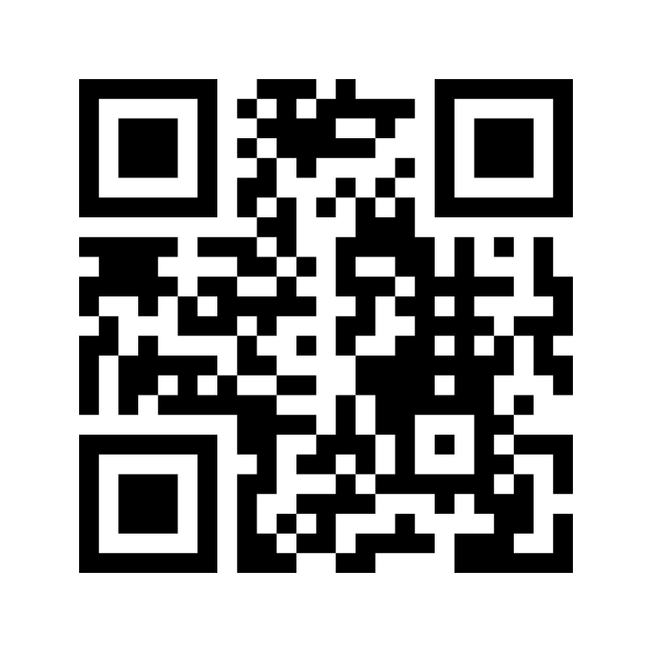
Mentimeter Poll
Scan QR Code
or Go to www.menti.com and use code
1183 9575
Notes:
https://www.menti.com/9r2wwujwag

Slide 89

Hands-On Build Activity: Azure Defender Part 2
Objective: As a result of participating in this lab, you will be better able to TODO.
What you will be doing: Like the Part 1 exercise, you work individually in your lab environment to complete a set of tasks you would typically follow in work associated with ingesting and integrating your customer’s data. A set of tasks are outlined for you to follow and complete.
Total Activity Time: 60 minutes

Slide 90


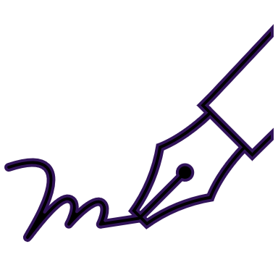






Lab: individual lab exercise
Step 1: Go to your table group channel
Step 2: Your Learning Adviser will provide you a unique cloud lab login link
Step 3: Login and begin the lab. Engage your table group via a Microsoft Teams “meet now” call to support each other (meet now button in upper right corner of application)

Slide 91
Closing
Thank you for your participation in today’s Azure Synapse Technical Boot Camp!
We learned:
File Integrity
Adaptive Application and Network Hardening
VM and SQL Vulnerability Assessment
Container Instance Monitoring
TODAY
We will learn to:
Azure Sentinel
Azure Sentinel + Azure Defender
TOMORROW

